Slide 1
MATH6380o Mini-Project 1
Feature Extraction and Transfer Learning on Fashion-MNIST
Jason WU, Peng XU, Nayeon LEE
08.Mar.2018

Slide 2
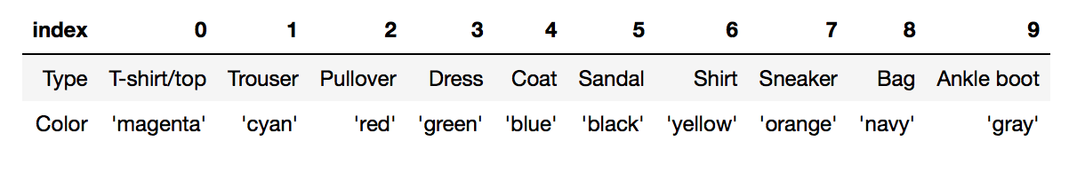
Introduction: Fashion-MNIST Dataset
60,000 training examples and a 10,000 testing examples
Each example is a 28x28 grayscale image
10 classes
Zalando et al. intend Fashion-MNIST to serve as a direct drop-in replacement for the original MNIST dataset for benchmarking machine learning algorithms.
Material: https://github.com/zalandoresearch/fashion-mnist

Slide 3
Why Fashion-MNIST?
Quoted from their website:
MNIST is too easy. Convolutional nets can achieve 99.7% on MNIST. Classic machine learning algorithms can also achieve 97% easily. Most pairs of MNIST digits can be distinguished pretty well by just one pixel.
MNIST is overused. In this April 2017 Twitter thread, Google Brain research scientist and deep learning expert Ian Goodfellow calls for people to move away from MNIST.
MNIST can not represent modern CV tasks, as noted in this April 2017 Twitter thread, deep learning expert/Keras author François Chollet.
Material: https://github.com/zalandoresearch/fashion-mnist

Slide 4
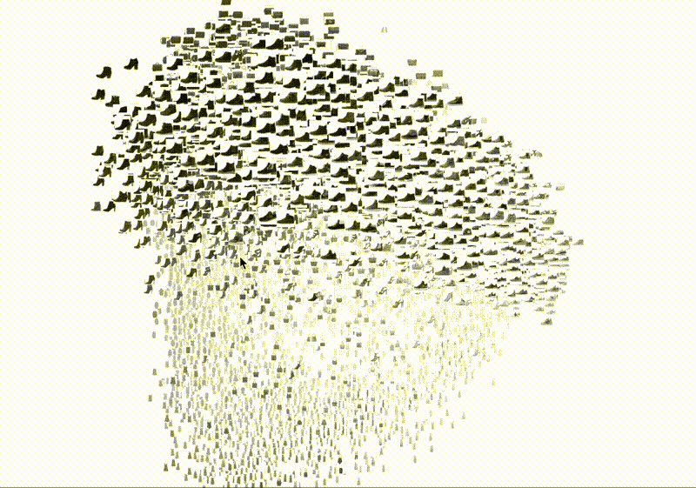
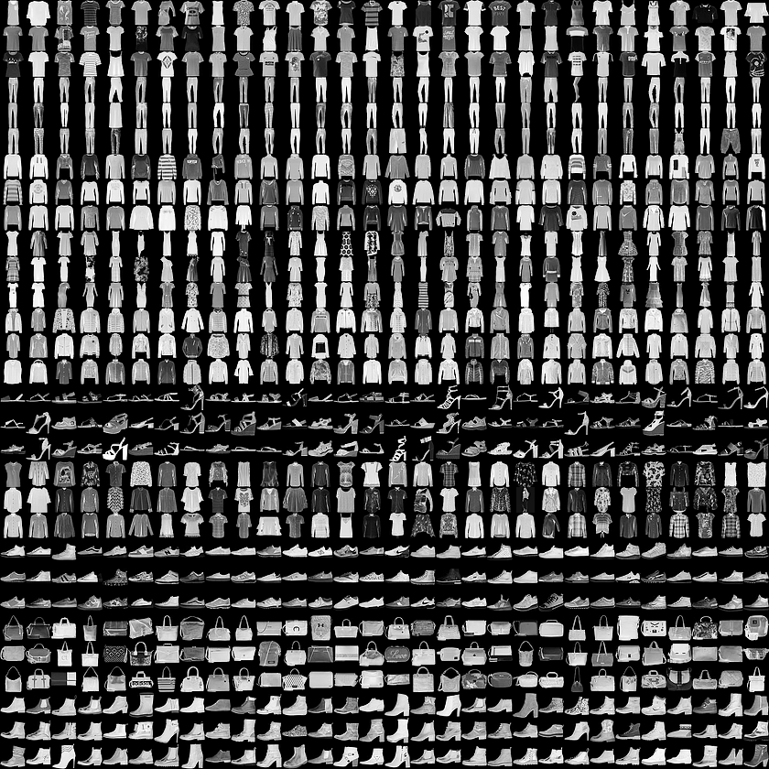
Introduction: Fashion-MNIST Dataset
Material: https://github.com/zalandoresearch/fashion-mnist

Slide 5
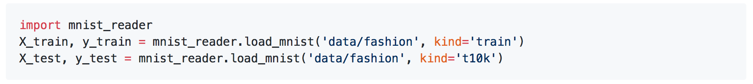
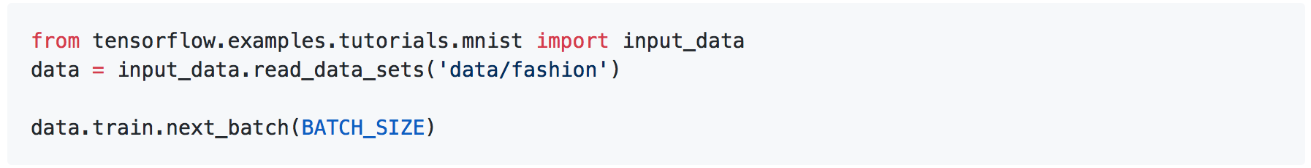
How to import?
Loading data with Python (requires NumPy)
Use utils/mnist_reader from https://github.com/zalandoresearch/fashion-mnist
Loading data with Tensorflow
Make sure you have downloaded the data and placed it in data/fashion. Otherwise, Tensorflow will download and use the original MNIST.
Material: https://github.com/zalandoresearch/fashion-mnist

Slide 6
Feature Extraction
We compared three different feature representation:
Raw pixel features
ScatNet features
Pretrained ResNet18 last-layer features

Slide 7
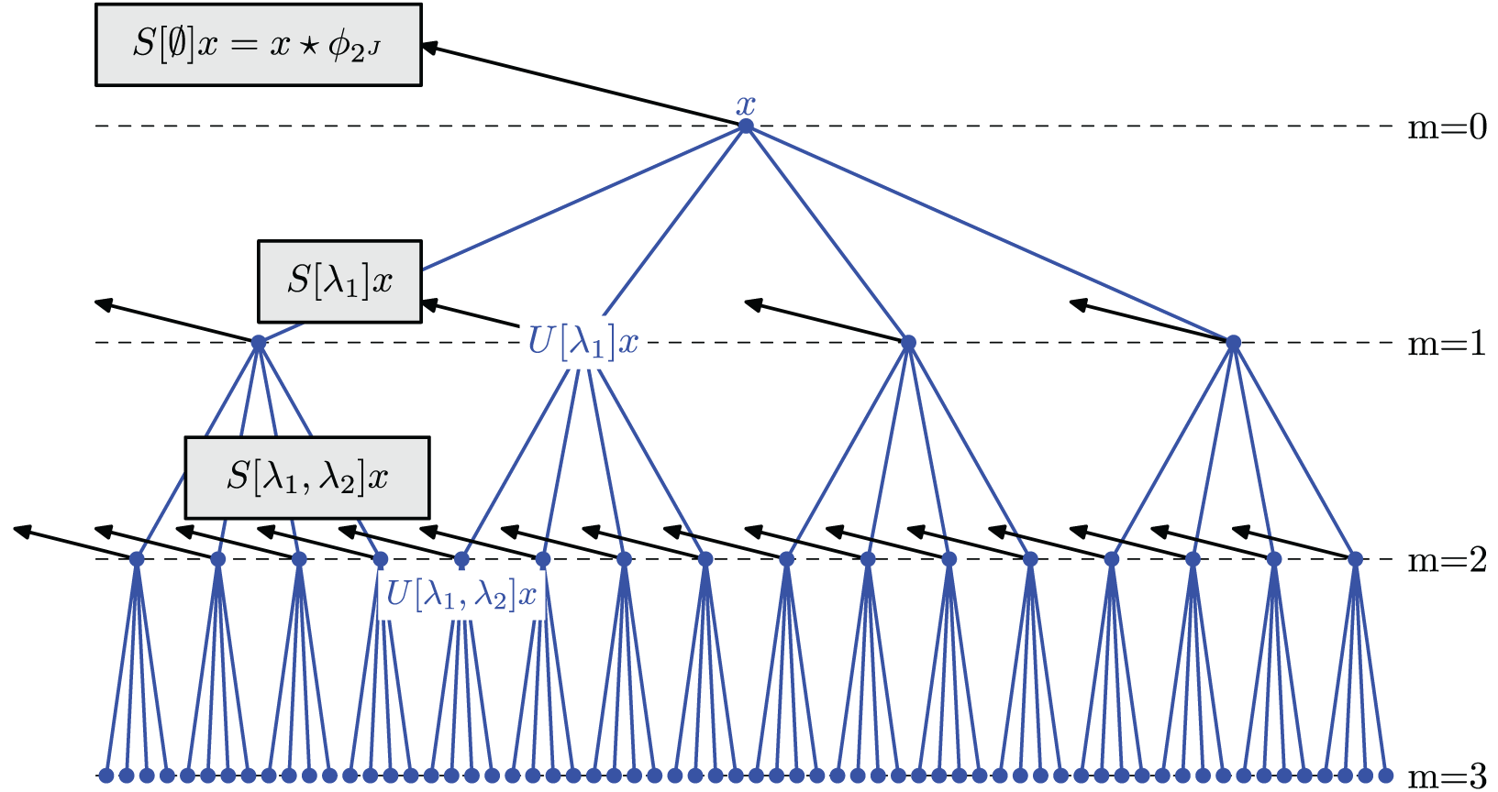
Feature Extraction(1): ScatNet
The maximum scale of the transform: J=3
The maximum scattering order: M=2
The number of different orientations: L=1
The dimension of the final features is 176
https://arxiv.org/pdf/1203.1513.pdf

Slide 8
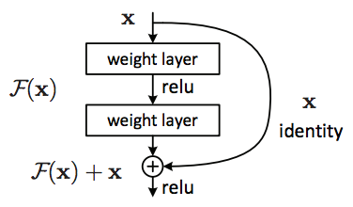
Feature Extraction(2): ResNet
Used pretrained 18 layers Residual Network from ImageNet
We take the hidden representation right before the last fully-connected layer, which has the dimension of 512
https://arxiv.org/abs/1512.03385

Slide 9
Data Visualization
Then, we visualized three different feature representation by the following 4 different dimension reduction methods:
Principal Component Analysis (PCA)
Locally Linear Embedding (LLE)
t-Distributed Stochastic Neighbor Embedding (t-SNE)
Uniform Manifold Approximation and Projection (UMAP)

Slide 10









Data Visualization
Then, we visualized three different feature representation by the following 4 different dimension reduction methods:
Principal Component Analysis (PCA)
Locally Linear Embedding (LLE)
t-Distributed Stochastic Neighbor Embedding (t-SNE)
Uniform Manifold Approximation and Projection (UMAP)

Slide 11
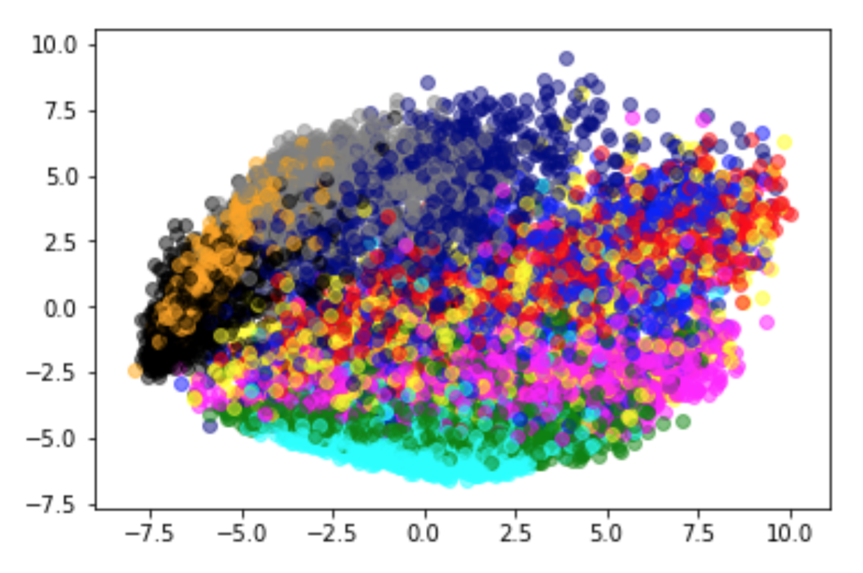
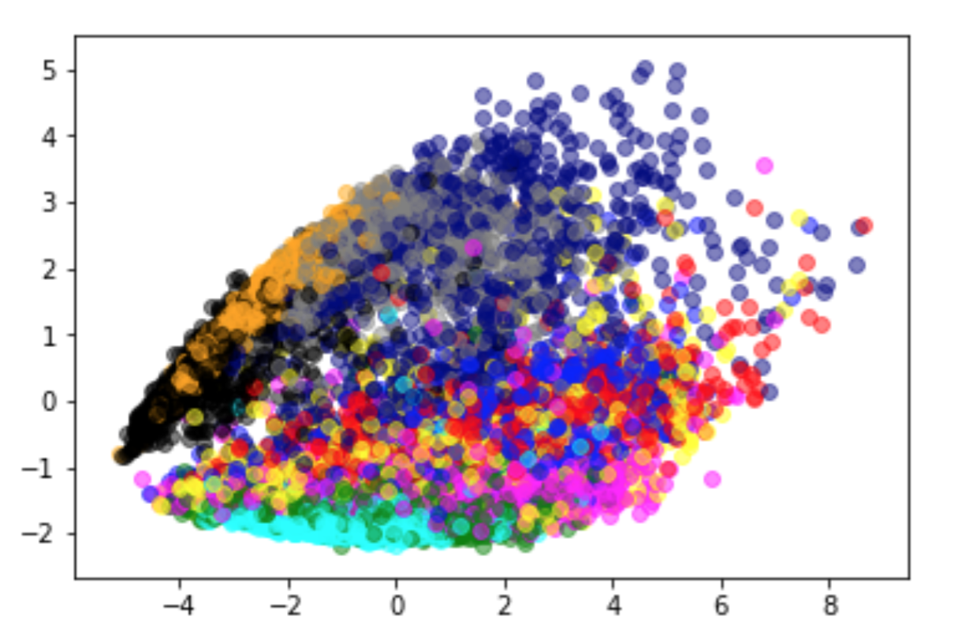
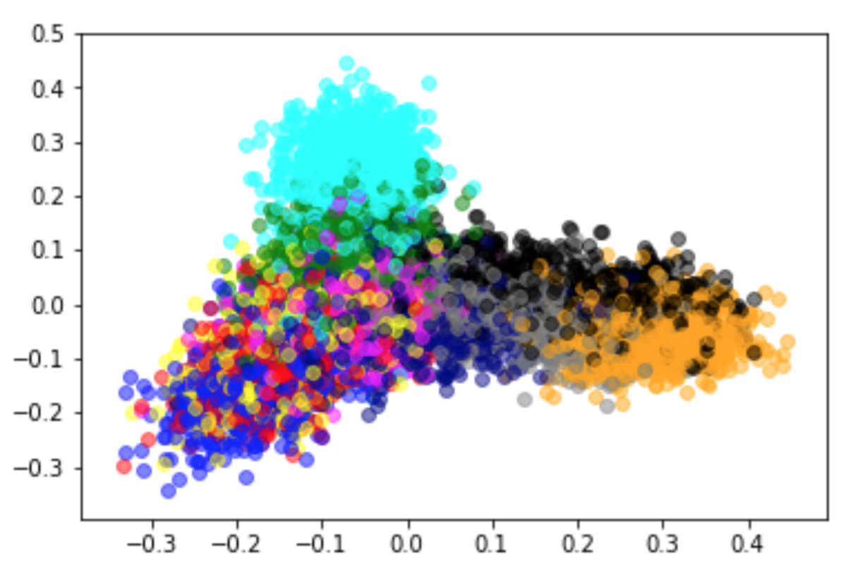
Data Visualization (1): PCA
Raw Features
ScatNet Features
ResNet Features
Normalization, Covariance Matrix, SVD, Project to top K eigen-vectors
Linear dimension reduction methods:
not that obviously difference between labels

Slide 12
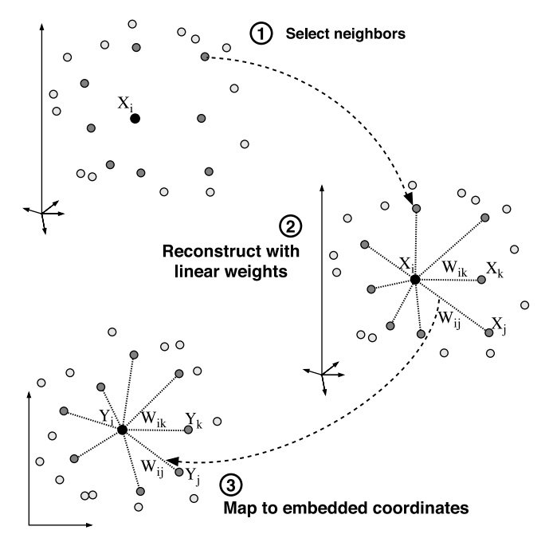
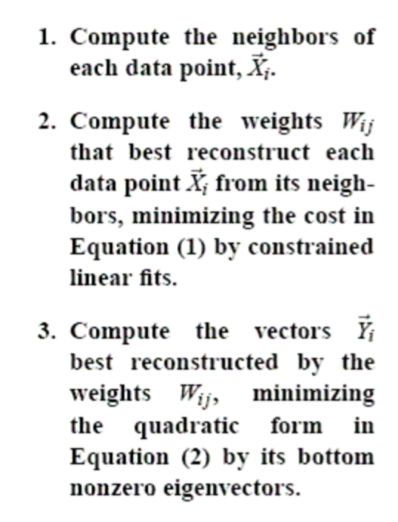
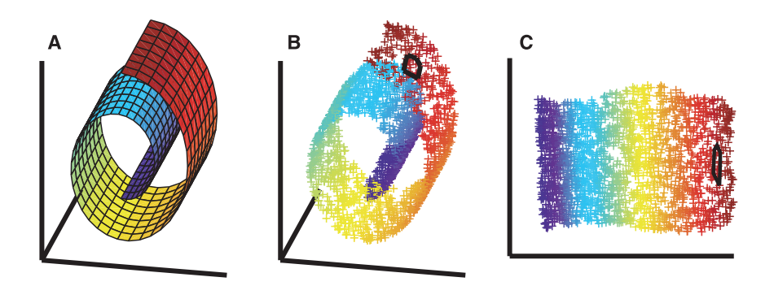
Data Visualization (2): LLE
http://www.robots.ox.ac.uk/~az/lectures/ml/lle.pdf

Slide 13
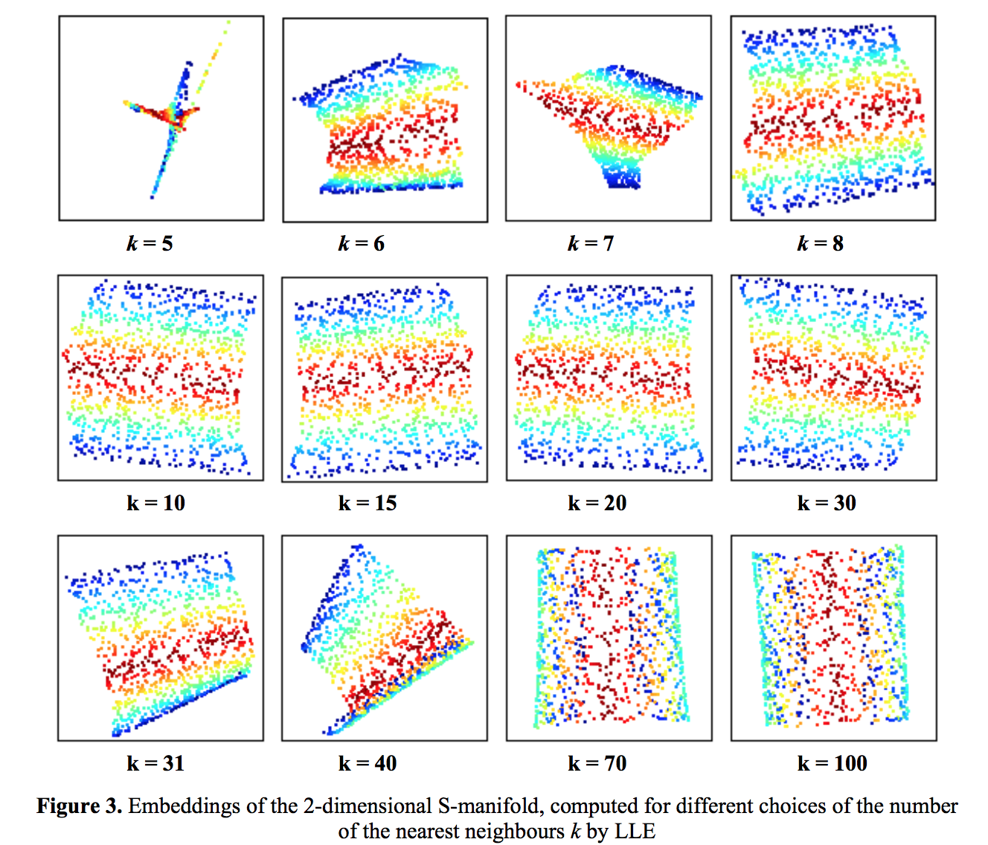
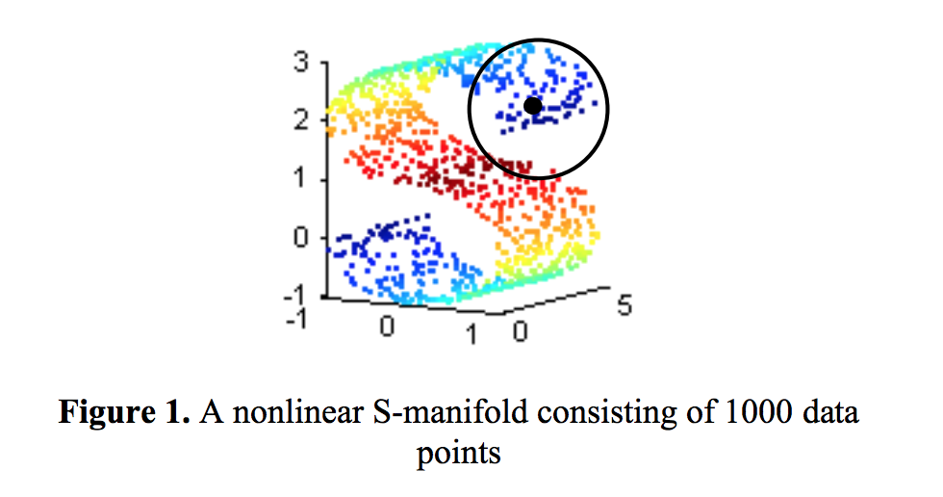
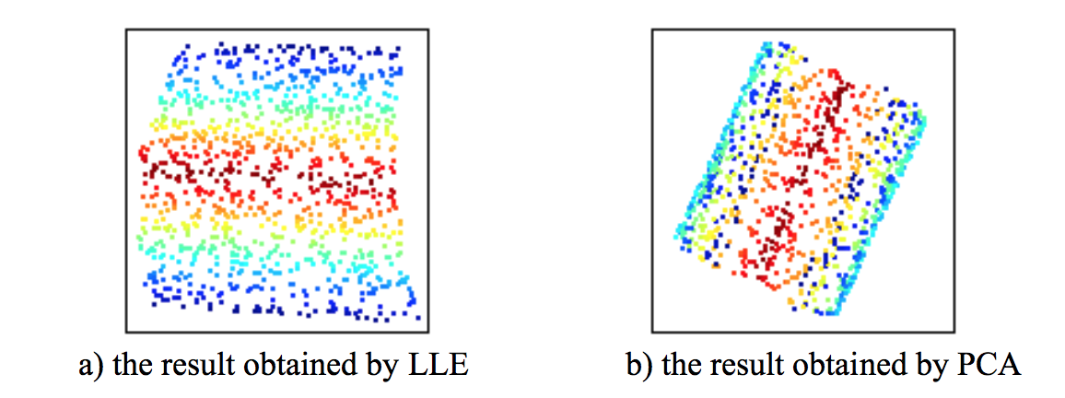
Data Visualization (2): LLE
https://pdfs.semanticscholar.org/6adc/19cf4404b9f1224a1a027022e40ac77218f5.pdf

Slide 14
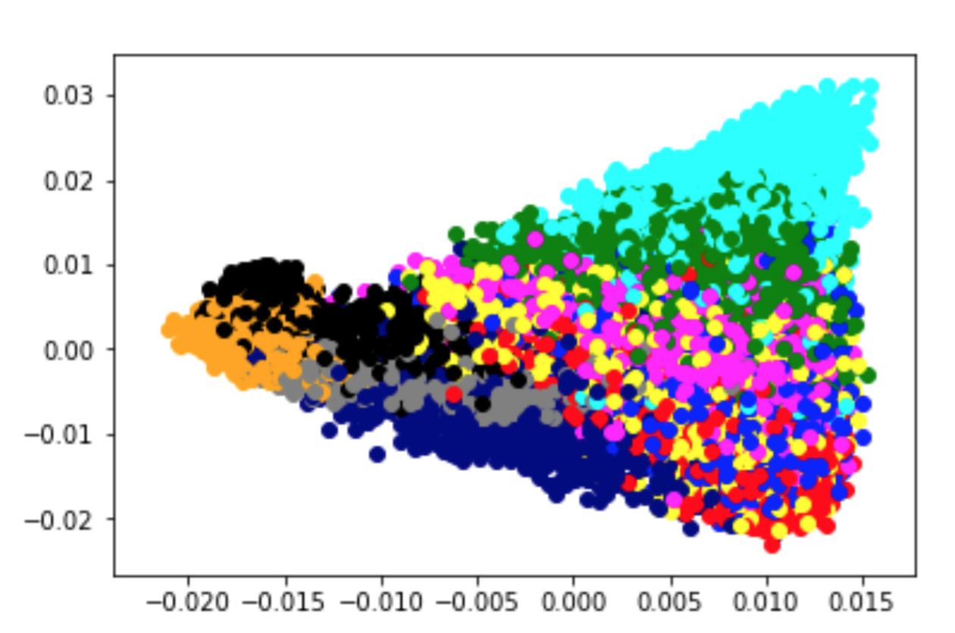
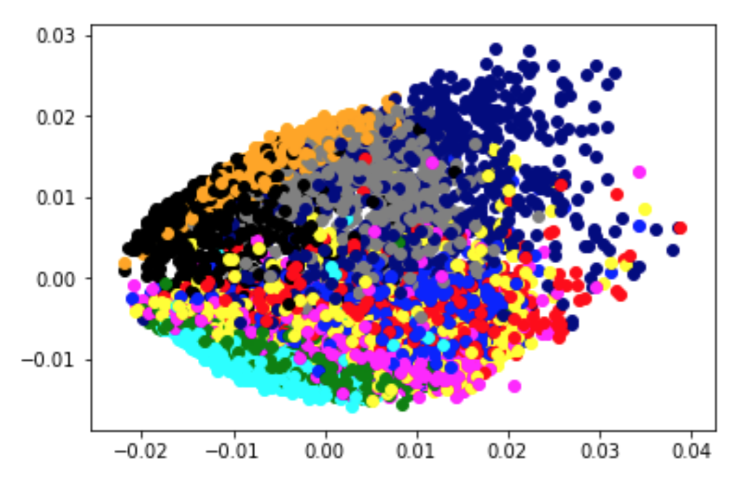
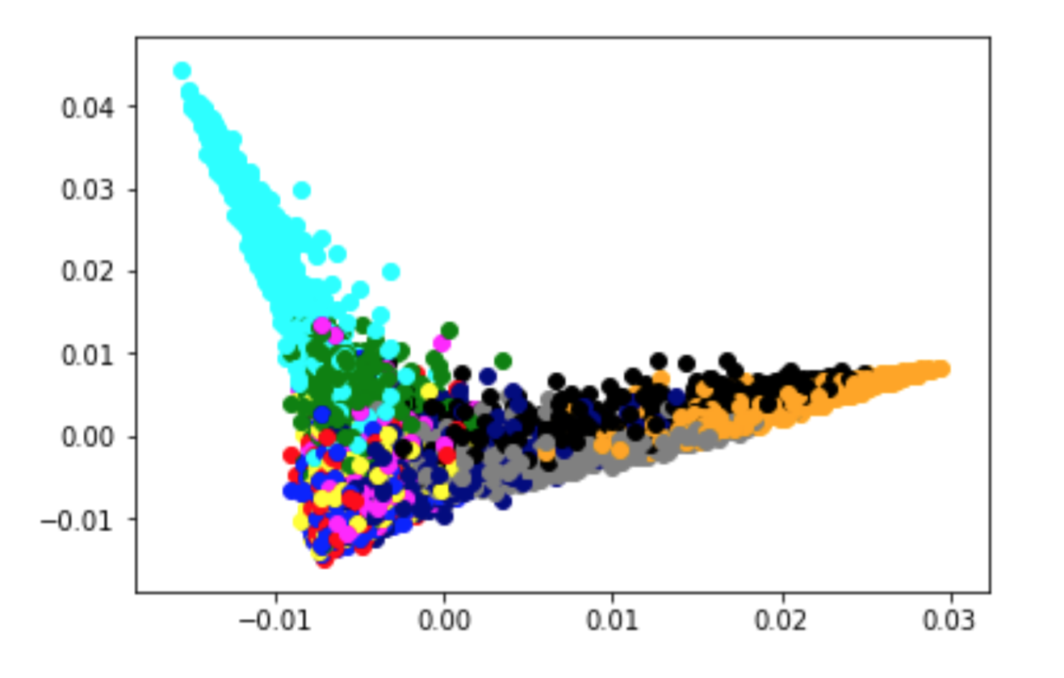
Data Visualization (2): LLE
Raw Features
ScatNet Features
ResNet Features
Non-linear dimension reduction that is good at capture “streamline” structure

Slide 15
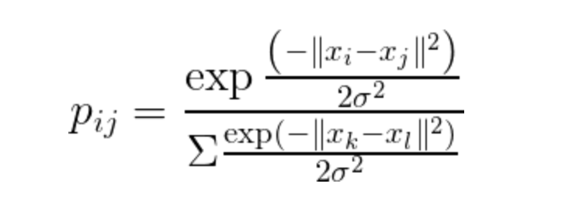
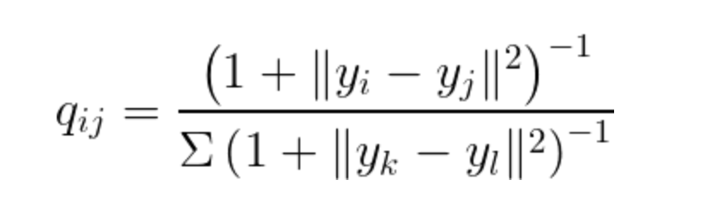
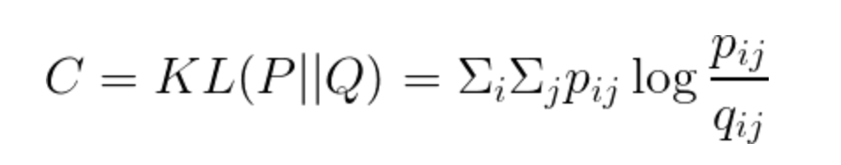
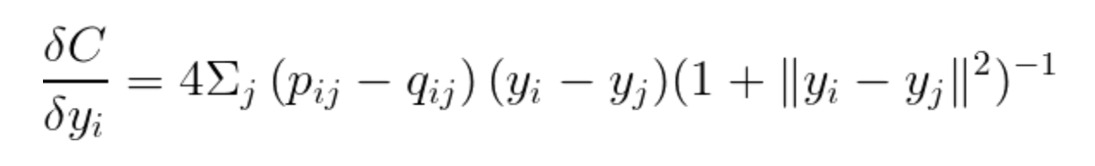
Data Visualization (3): t-SNE
Use Gaussian pdf to approximate the high dimension distribution
Use t distribution for low dimension distribution
Use KL Divergence as cost function for gradient descent
http://www.jmlr.org/papers/volume9/vandermaaten08a/vandermaaten08a.pdf

Slide 16
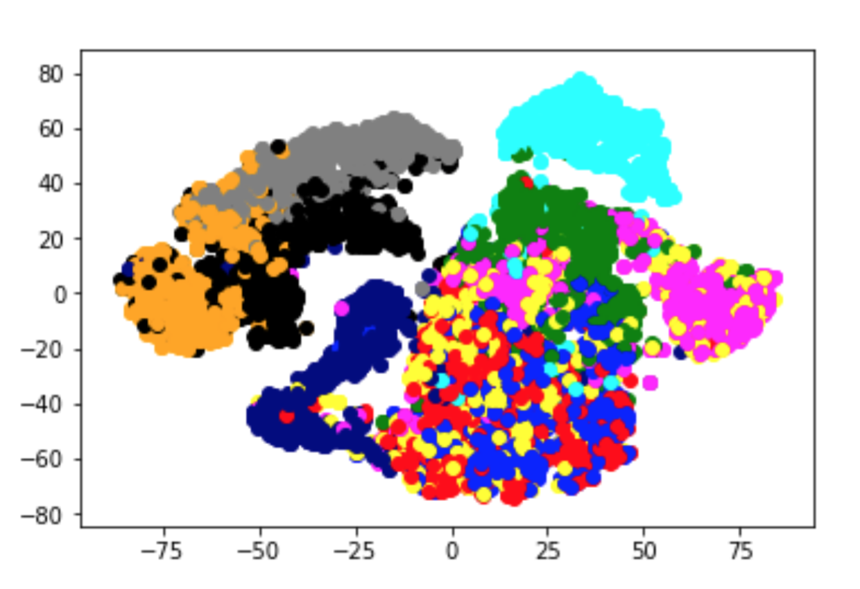
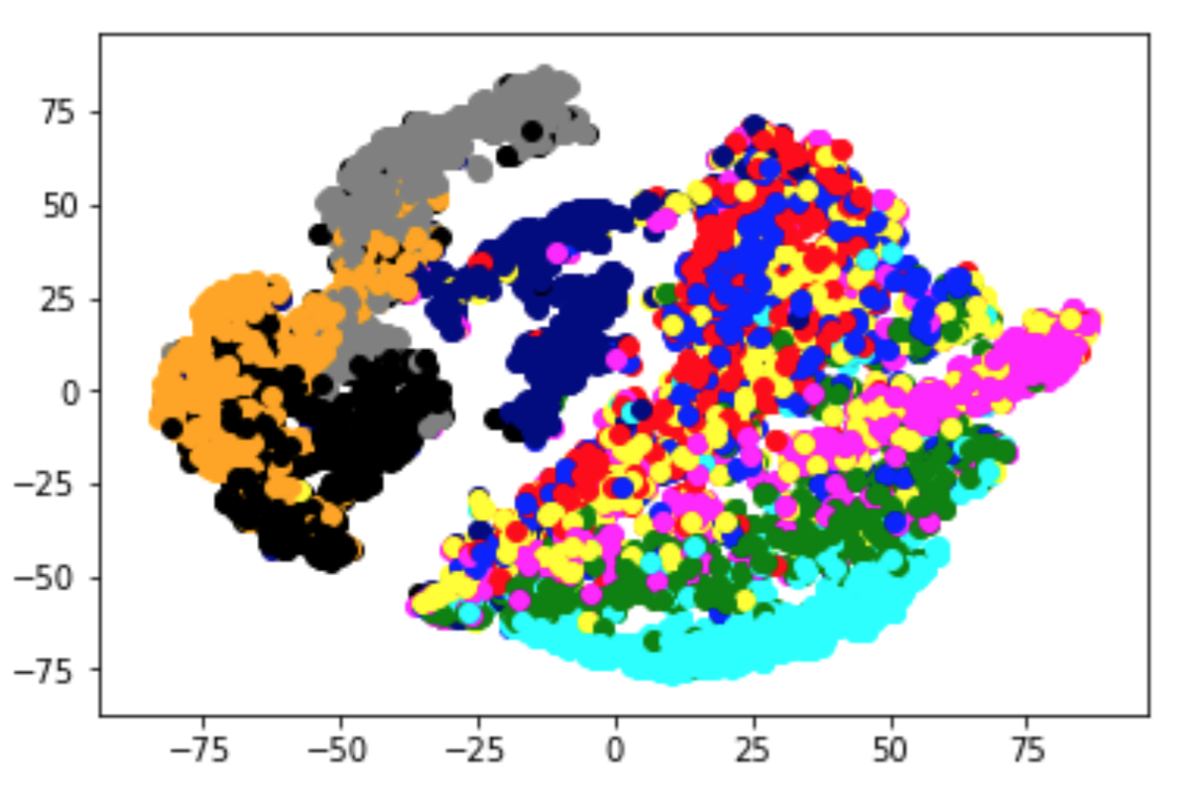
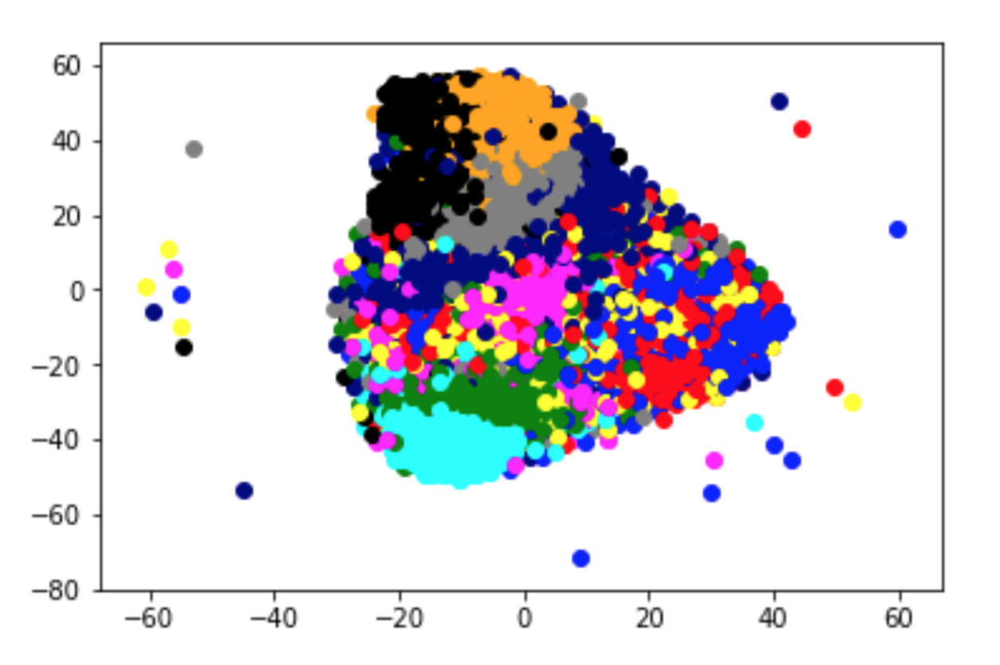
Data Visualization (3): t-SNE
Raw Features
ScatNet Features
ResNet Features
Block-like visualization due to the gaussian approximation

Slide 17
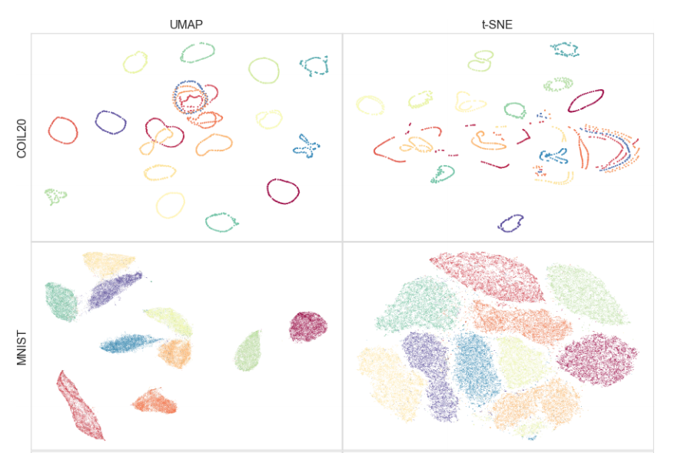
Data Visualization (4): UMAP
The algorithm is founded on three assumptions about the data
The Riemannian metric is locally constant (or can be approximated);
The data is uniformly distributed on Riemannian manifold;
The manifold is locally connected.
https://arxiv.org/pdf/1802.03426.pdf

Slide 18
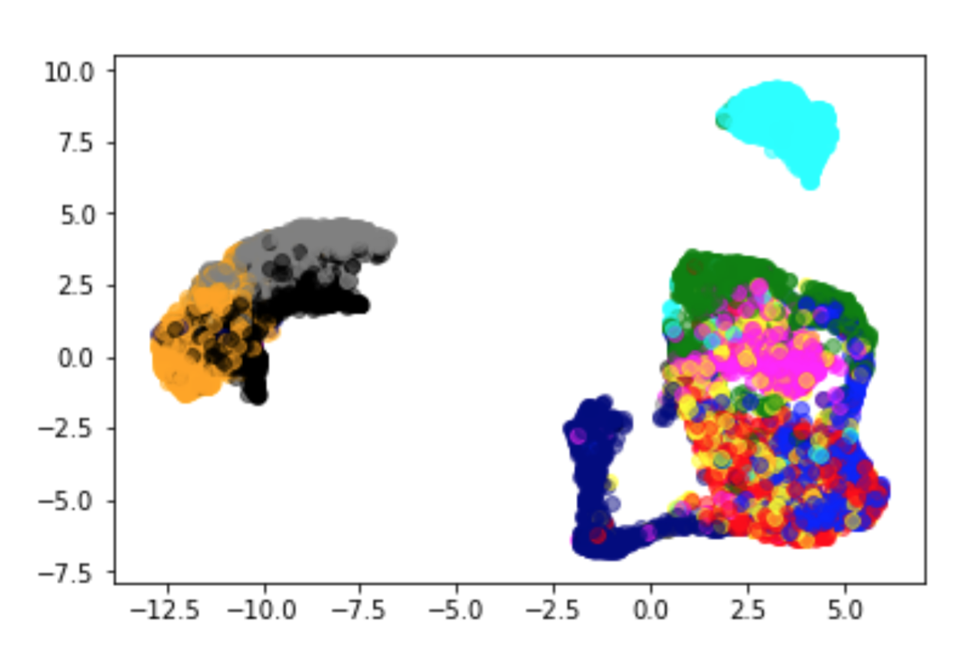
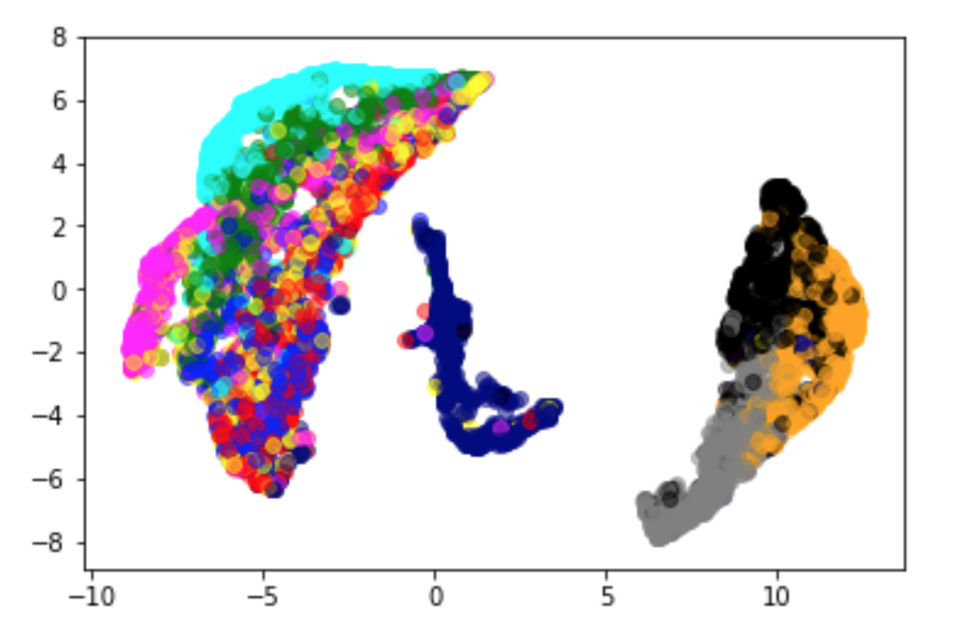
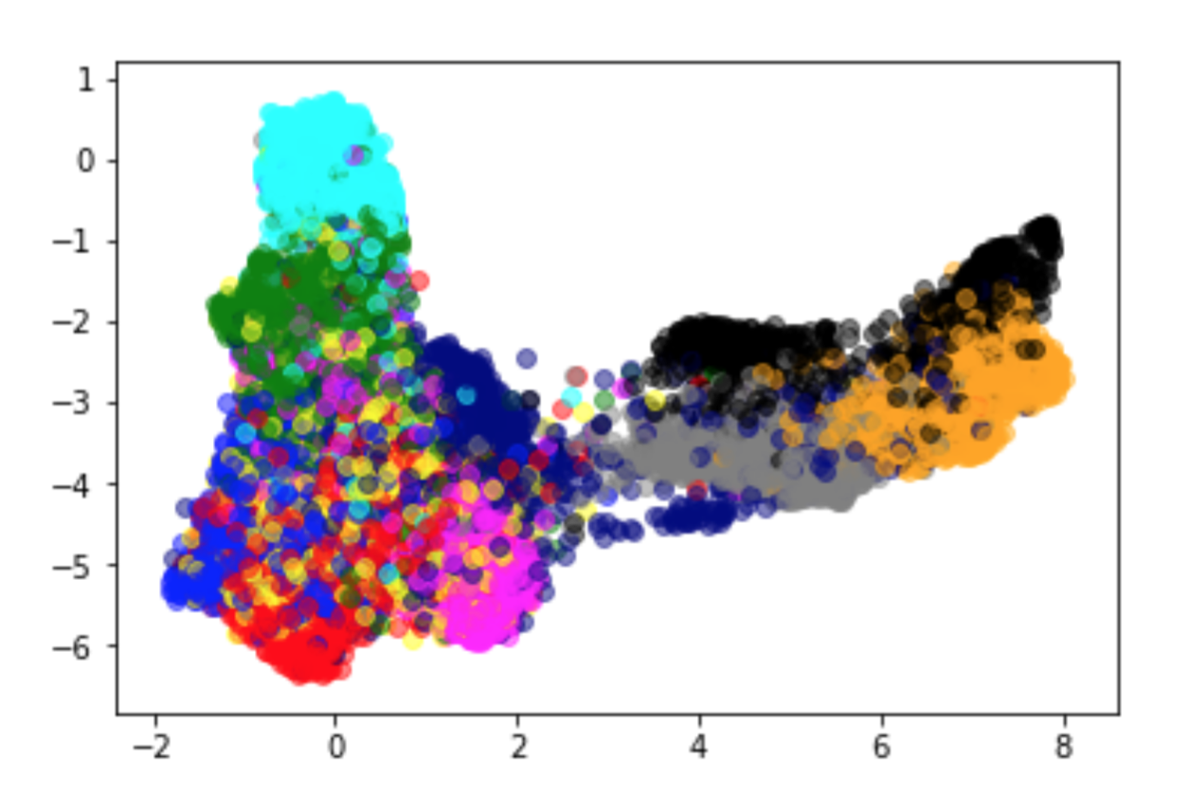
Data Visualization (4): UMAP
https://github.com/lmcinnes/umap
Raw Features
ScatNet Features
ResNet Features
Much more Faster in training process, which implies it can handle large datasets and high dimensional data

Slide 19
Any News from Visualization?
Is there different patterns between different visualization methods?
Is there clear separation of different classes?
Is there any groups that tend to cluster together?
Let’s look closer!

Slide 20
PCA
LLE

Slide 21
t-SNE
UMAP

Slide 22
Sneaker,
Sandal,
Ankle boot

Slide 23
PCA
LLE

Slide 24
t-SNE
UMAP

Slide 25
Trouser

Slide 26
PCA
LLE

Slide 27
t-SNE
UMAP

Slide 28
Bag

Slide 29
PCA
LLE

Slide 30
t-SNE
UMAP

Slide 31
T-Shirt,
Pullover,
Dress,
Coat,
Shirt

Slide 32
Simple Classification Models
Logistic Regression
Linear Discriminant Analysis
Support Vector Machine
Random Forest
...

Slide 33
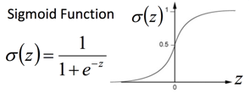
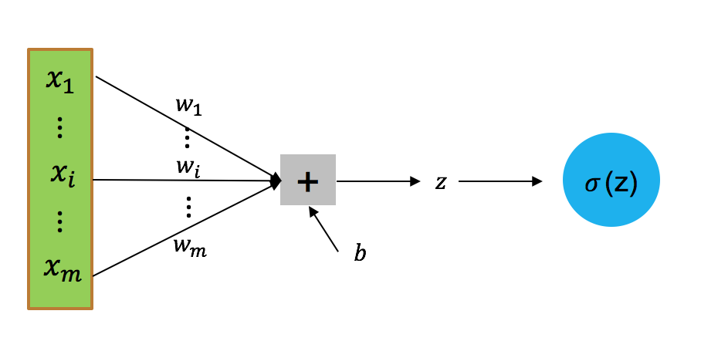
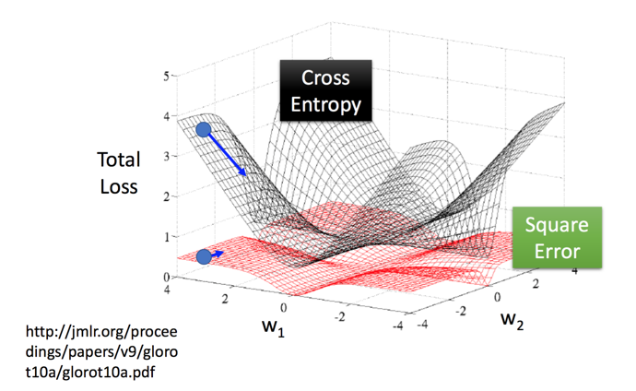
Simple Classification Models
Logistic Regression

Slide 34
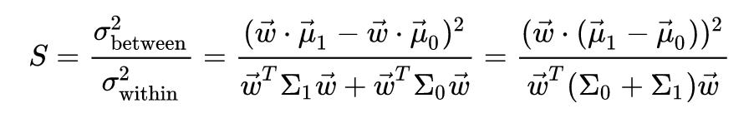
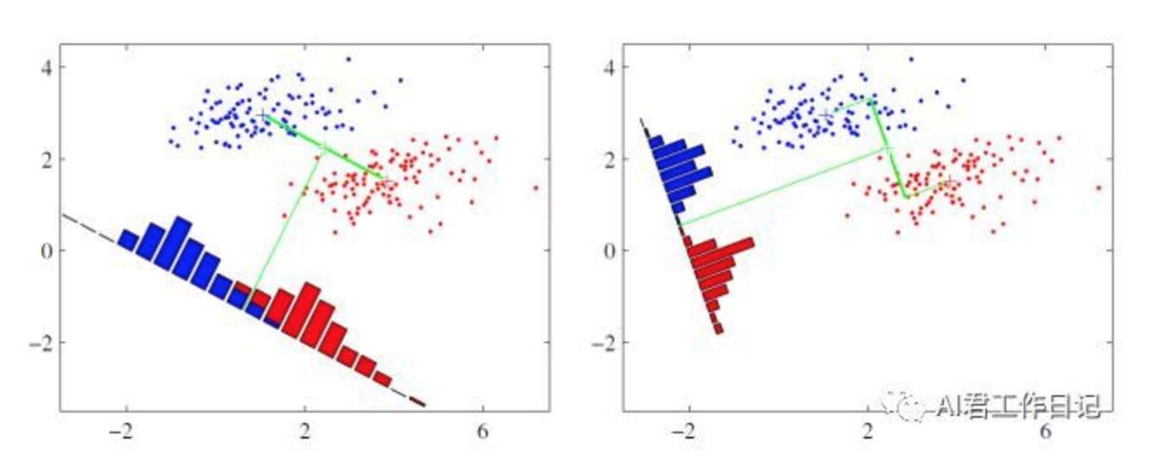
Simple Classification Models
Linear Discriminant Analysis
maximize between class covariance
minimize within class covariance

Slide 35
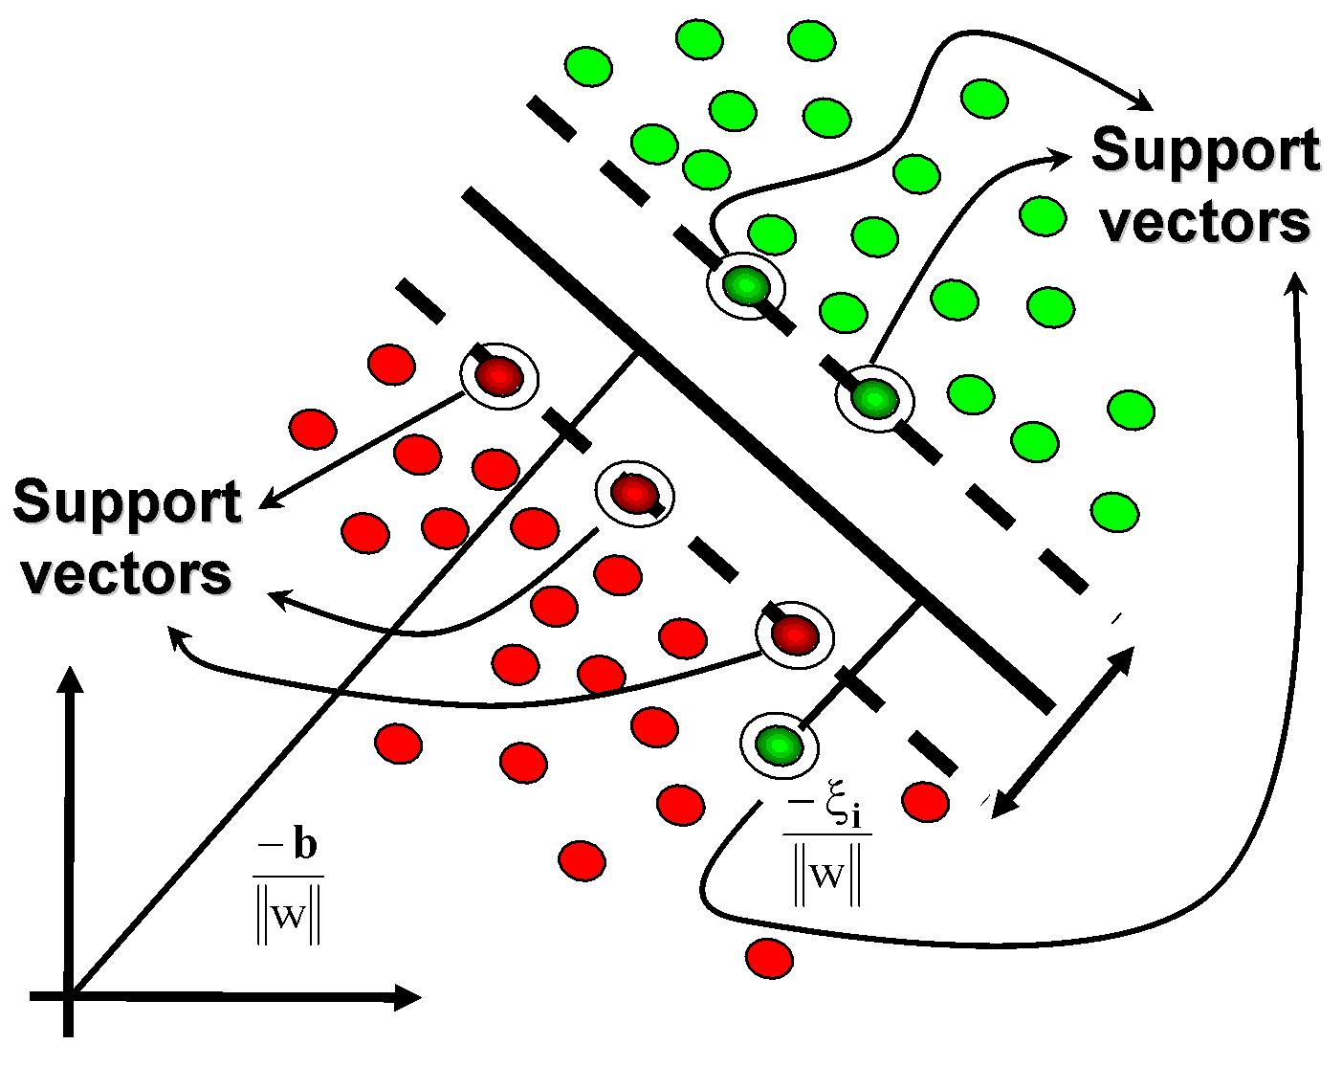
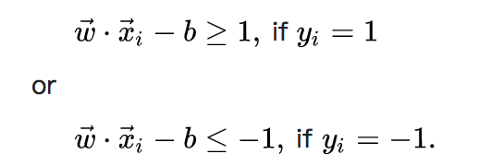
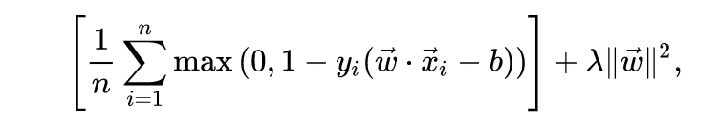
Simple Classification Models
Linear Support Vector Machine
Hard-margin
Soft-margin

Slide 36
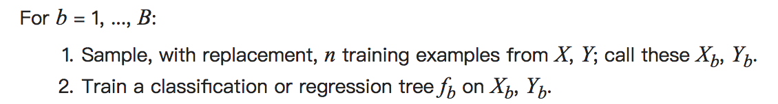

Simple Classification Models
Random Forest
An ensemble learning method that construct multiple decision trees
Bagging (Bootstrap aggregating)

Slide 37
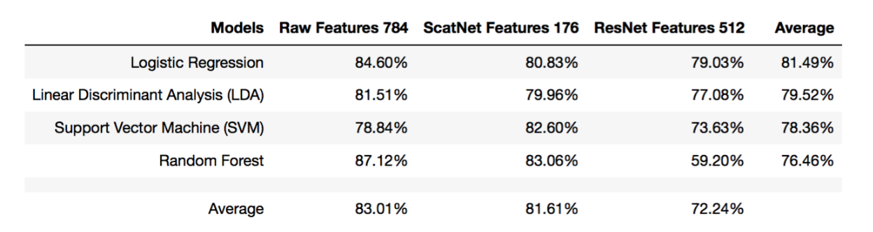
Simple Classification Results

Slide 38
Simple Classification Results

Slide 39
Simple Classification Results
http://fashion-mnist.s3-website.eu-central-1.amazonaws.com

Slide 40
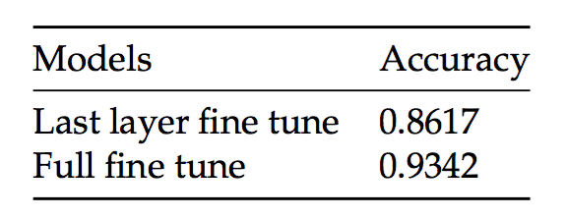
Fine-Tuning the ResNet
The best accuracy now is 93.42%
Seems like transfer learning in our case is not that promising.

Slide 41
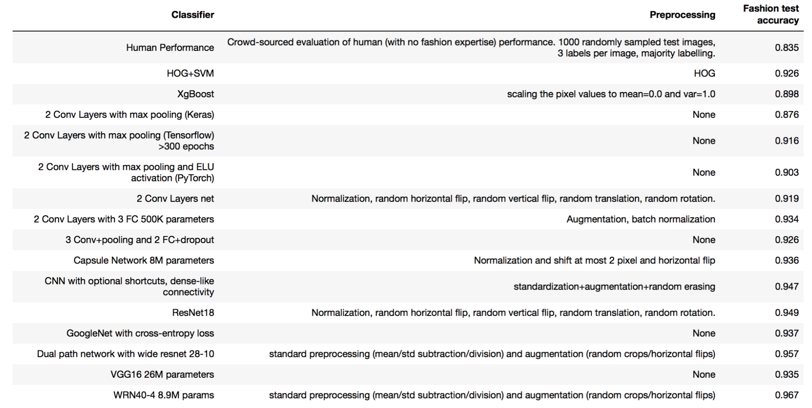
Other Existing Models...

Slide 42
Q/A
Hong Kong University of Science and Technology
Electronic & Computer Engineering
Human Language Technology Center (HLTC)
Jason WU, Peng XU, Nayeon LEE

